Slide 1
IEEE Volunteering Platform
volunteer.ieee.org

Slide 2
What is the IEEE Volunteering Platform?
Cross-IEEE solution for all IEEE members to advertise and search for volunteering
opportunities, be it short- or long-term, local or remote, or requiring different skills
Need volunteers? You can:
Share volunteering opportunities
Recruit volunteers or new team members
Track volunteering work
Want to volunteer? You can:
Browse or search for available volunteer opportunities
Apply to opportunities that interest you
Automatically generate your volunteering CV
Collect feedback and endorsements from volunteer leadership
Who can use the IEEE Volunteering platform?
All IEEE members can search for and create opportunities
Help others become part of IEEE’s mission by providing opportunities for the new #IEEEVolunteeringPlatform
volunteer.ieee.org
volunteer.ieee.org

Slide 3
Why use the IEEE Volunteering Platform?
Modern approach to volunteering
Simplify the process of volunteering with IEEE
Recruit volunteers
Provide flexible volunteering opportunities
Recognize volunteering efforts, regardless of duration or intensity
Enable a recommendation and feedback process
Encourage project-based, skill-based, and long-distance volunteering
Easily track your volunteering work through an automated volunteering CV
Encourage merit-based advancement along the IEEE career path
volunteer.ieee.org

Slide 4
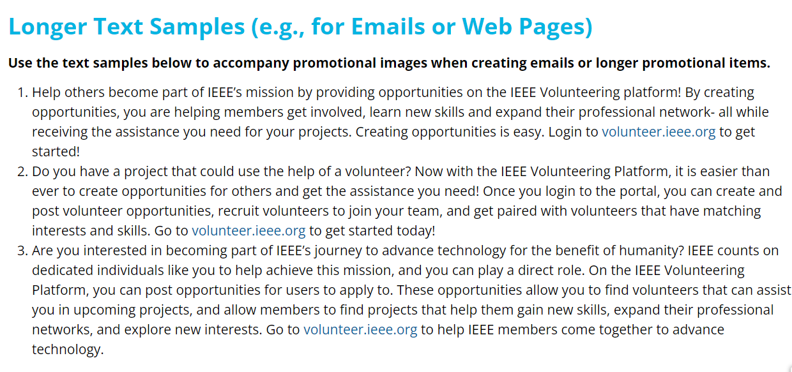
Call to Action - IEEE Volunteering Platform
Create opportunities and socialize using the Marketing Toolkit
Think about how to utilize this platform in your organizational units
Develop opportunities and encourage peers to do the same
Provide user feedback to volunteering@ieee.org
Use the new IEEE Volunteering Platform Marketing Toolkit to socialize within your organizational units:
Promotional ads
Banner ads
Print ads
Social media messaging samples
Email samples
https://brand-experience.ieee.org/ieee-volunteering-toolkit/

Slide 5
Creating Opportunities
Getting started
Identify volunteering opportunities
Are there tasks in your organizational unit that could benefit from having additional volunteers address them?
Are there any upcoming projects or activities that will require new team members?
Are there any short-term opportunities for volunteers to help?
Share the volunteering opportunities on the IEEE Volunteering platform
Include a good description and be clear what requirements candidates should fulfill
Promote the opportunity across your communication channels
Share the opportunity directly from the platform to your social media or via email to encourage more members from your target group to apply
Share the opportunity in your newsletter by providing the public link
volunteer.ieee.org

Slide 6
Opportunity Creation Ideas
A few ideas for areas where you might need help
Conference meet and greet/registration desk support
Peer review of papers
Assistance with marketing materials or social media posts
Committee/unit subteams, working groups, or ad hoc needs
Co-host a webinar and monitor Chat/Q&A
Recruit speakers for presentations
Specific Region, Section, Society, Council, Student Branch, Chapter, Affinity Group, Community, or organizational unit projects
Check out the current opportunities on the platform for more ideas!
#IEEEVolunteeringPlatform:
Where opportunity meets flexibility!
volunteer.ieee.org
volunteer.ieee.org

Slide 7
Enhancing the IEEE Volunteering Platform
IEEE Volunteering roadmap includes:
New developments and improvements to the user interface and process flows
Reporting features
Integration with other services such as the IEEE App, vTools, and IEEE Collabratec™
An aggregate CV
Engaging and measuring the impact of IEEE Volunteers
volunteer.ieee.org

Slide 8
Feedback or Questions?
email volunteering@ieee.org

Slide 9
Appendix: Exploring the Platform
A Walk-Through

Slide 10
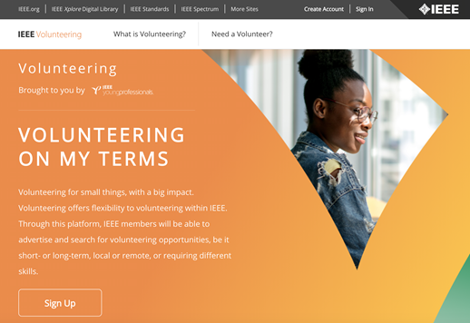
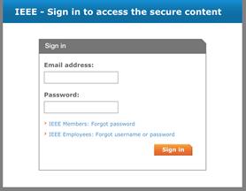
Getting Started
Access the platform using your IEEE credentials
volunteer.ieee.org

Slide 11
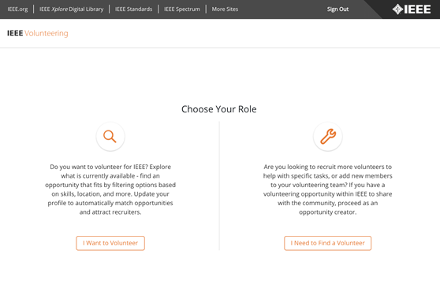
Selecting a Role
The platform provides you with two options
volunteer.ieee.org

Slide 12
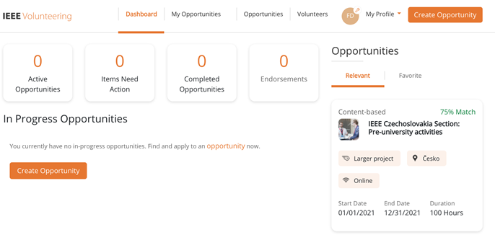
Dashboard Navigation
Your dashboard provides a quick overview of your activity on the platform
volunteer.ieee.org

Slide 13
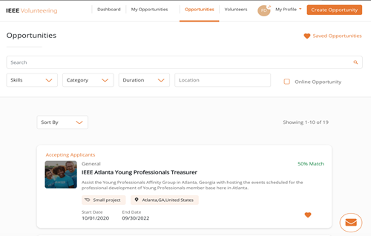
Searching for Opportunities
Members and volunteers can find opportunities using simple search terms
volunteer.ieee.org

Slide 14
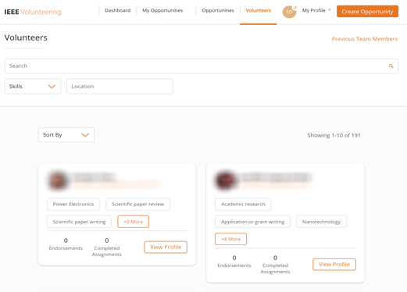
Searching for Volunteers
Team members can be found using memberships, endorsements, skills, location
volunteer.ieee.org

Slide 15
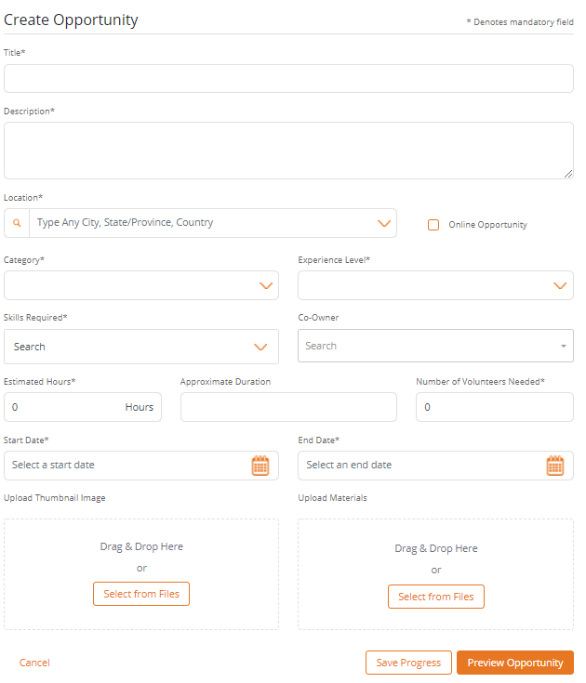
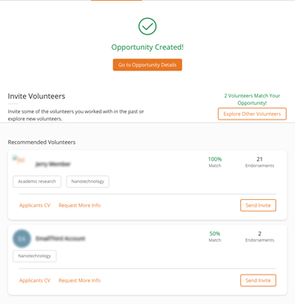
Creating a New Volunteering Opportunity
It takes about 3 minutes to publish a new opportunity
volunteer.ieee.org

Slide 16
Providing Feedback and Endorsements
Acknowledge the effort and completion of assignments for your team
volunteer.ieee.org

Slide 17
Feedback or Questions?
email volunteering@ieee.org

